Slide 1
Additional Techniques
Generics
Declaration files

Slide 2
1. Generics
Defining generic functions
Calling generic functions
Specifying type constraints
Defining generic classes
Using generic classes
2

Slide 3
Defining Generic Functions
TS lets you define generic functions
Use the <Type> syntax to define a type parameter
Use the type parameter for static typing within the function
function min<Type>(arr: Type[]): Type | undefined {
console.log(`Called min() with an array of ${typeof arr[0]}`);
let smallest: Type | undefined = arr[0];
for (let i = 1; i < arr.length; i++) {
if (arr[i] < smallest) {
smallest = arr[i];
}
}
return smallest;
}
genericFunctions.ts
3

Slide 4
Calling Generic Functions
When you call a generic function, you can pass the type parameter in explicitly
If the type parameter appears in the function signature, you can omit the type parameter in the call
genericFunctions.ts
const r1 = min<number>([3, 12, 19, 1, 2, 7]);
const r2 = min([3, 12, 19, 1, 2, 7]);
const r3 = min(['Huey', 'Lewey', 'Dewey']);
const r4 = min([]);
genericFunctions.ts
4

Slide 5
Specifying Type Constraints
You can specify constraints on type parameters, to ensure the incoming type has requisite members
function shorter<Type extends { length: number }>(arg1: Type, arg2: Type) {
console.log(`Arg lengths ${arg1.length}, ${arg2.length}`);
return arg1.length < arg2.length ? arg1 : arg2;
}
const r1 = shorter("Thomas", "Emily");
const r2 = shorter([10, 20], [30, 40, 50]);
const r3 = shorter({width: 100, length: 200}, {width: 300, length: 400});
typeConstraints.ts
5

Slide 6
Defining Generic Classes
TS lets you define generic classes (and interfaces)
Use the <Type> syntax to define a type parameter
Use the type parameter for static typing in the class/interface
class CyclicBufferV1<Type> {
private data: Type[];
private currentPos = 0;
constructor(private length: number) {
this.data = new Array<Type>(length);
}
insert(value: Type) {…}
get(index: number) : Type {…}
display() {…}
}
genericClassesV1.ts
6

Slide 7
Using Generic Classes
When you create an instance of a generic class, you can specify the type parameter explicitly
If the type parameter appears in the constructor signature, you can omit the type parameter when you create an obj
genericClassesV1.ts
let cb1 = new CyclicBufferV1<number>(6);
class CyclicBufferV2<Type> {
constructor(...data: Type[]) {…}
…
}
let cb2 = new CyclicBufferV2(3, 12, 19, 1, 2, 7);
genericClassesV2.ts
7

Slide 8
2. Declaration Files
The need for declaration files
Declaration files to the resue
Using declaration files

Slide 9
The Need for Declaration Files (1 of 3)
Take a look in this folder:
Modules_Without_DeclarationFiles
We have an existing JS file (module)
my-module.js
Doesn’t contain any type info!
We import it into a TS file (module)
index.ts
We accidentally pass some incorrect types into functions!
9

Slide 10
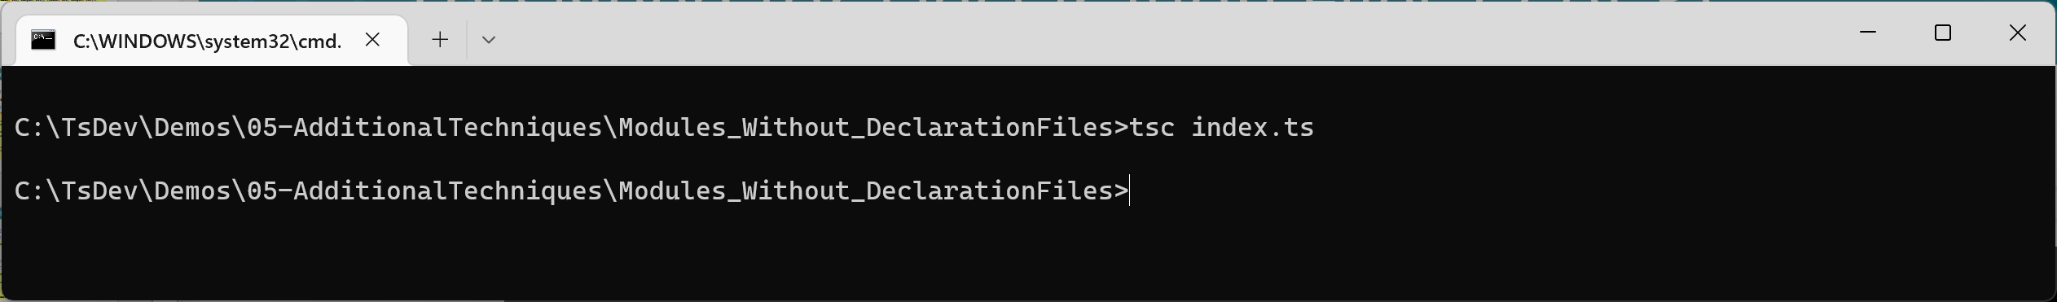
The Need for Declaration Files (2 of 3)
When we compile the TS file…
The TS compiler doesn’t report any errors
Because it didn't know what types the JS functions expected
tsc index.ts
10

Slide 11
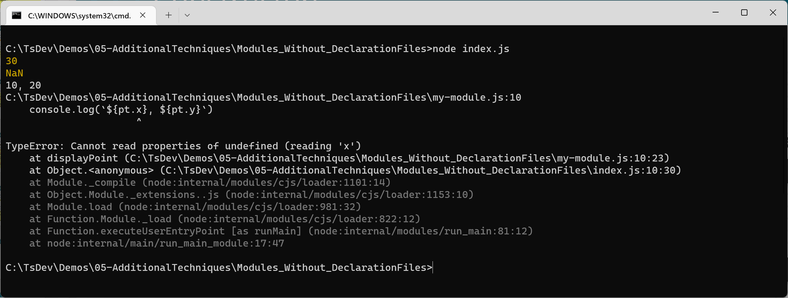
The Need for Declaration Files (3 of 3)
This means we get errors at run-time instead
node index.js
😱
11

Slide 12
Declaration Files to the Rescue
The preferred way to integrate JS code into TS is to define a declaration file
Same name/folder as JS file, with a file extension .d.ts
Specifies type info to accompany the JS code
Enables the TS compiler to do full type checking
See following slides for an example…
12

Slide 13
Using Declaration Files (1 of 3)
Take a look in this folder:
Modules_With_DeclarationFiles
The JS module is the same as before
my-module.js
We've now defined an accompanying declaration file
my-module.d.ts
Specifies type info to accompany the JS module
13

Slide 14
Using Declaration Files (2 of 3)
Now take a look at index.ts
Note the import statement in particular:
This automatically imports 2 files:
my-module.js - Implements functions, etc.
my-module.d.ts - Declares types for functions, etc.
This enables the TS compiler to ensure that we use the correct types when calling into JS code
import { add, subtract, displayPoint } from './my-module';
14

Slide 15
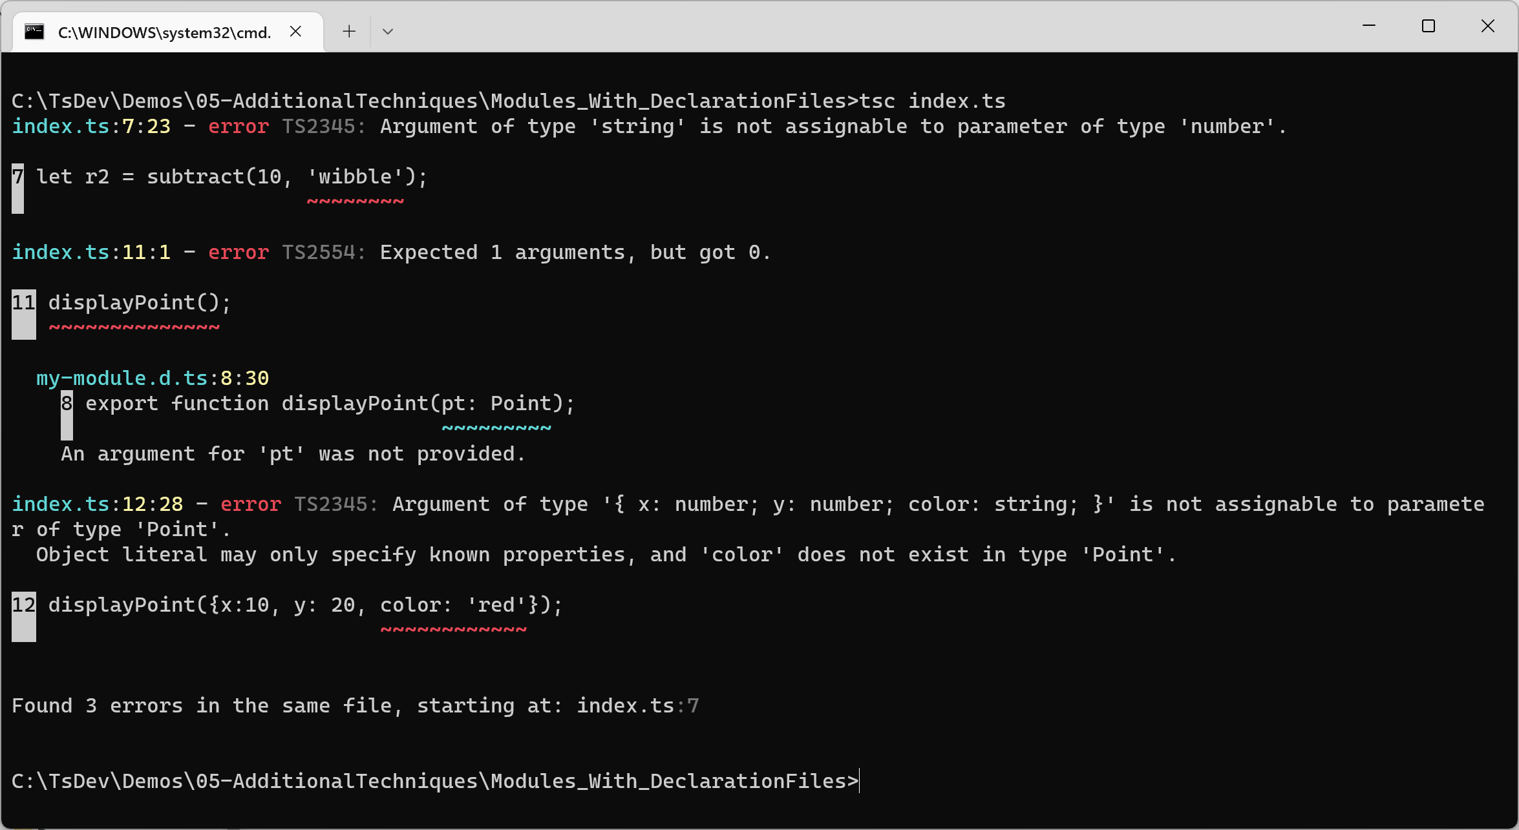
Using Declaration Files (3 of 3)
The TS compiler is now capable of detecting type errors
tsc index.ts
👍
15

Slide 16
Summary
Generics
Declaration files

